Slide 1
Fonds "Fonds de solidarité Truffaut-Delbrouck" (265211)
June 17 2009 at 9:06:29

Slide 2
Exposition internationale de l'eau (Liège 1939) (265376)
June 17 2009 at 2:06:54

Slide 3
Fonds Georges Truffaut (269465)
July 6 2009 at 3:07:01

Slide 4
Georges Truffaut, mon père (1893305)
August 27 2012 at 2:08:43

Slide 5
Presse (3349870)
July 10 2014 at 4:07:50

Slide 6
Correspondance (3349871)
July 10 2014 at 4:07:38

Slide 7
Photos (3349872)
July 10 2014 at 4:07:53

Slide 8
Publications officielles (3349873)
July 10 2014 at 4:07:37

Slide 9
Port autonome et Canal Albert (3349874)
July 10 2014 at 4:07:41

Slide 10
Le Grand Liège (3349875)
July 10 2014 at 4:07:28

Slide 11
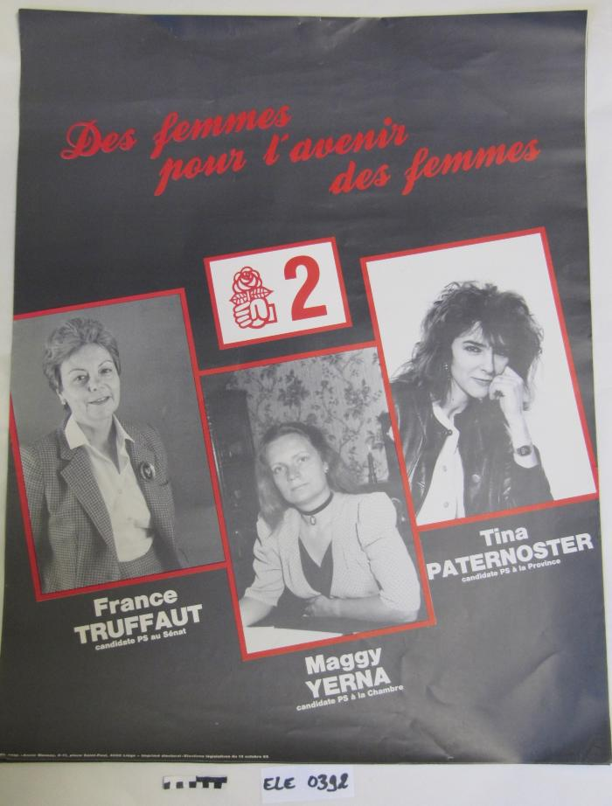
Des femmes pour l'avenir des femmes (ARC-C AFF ELE 0392)

Slide 12
Fonds France Truffaut (ARC-P TRU-F)
July 6 2009 at 3:07:01

