Slide 1
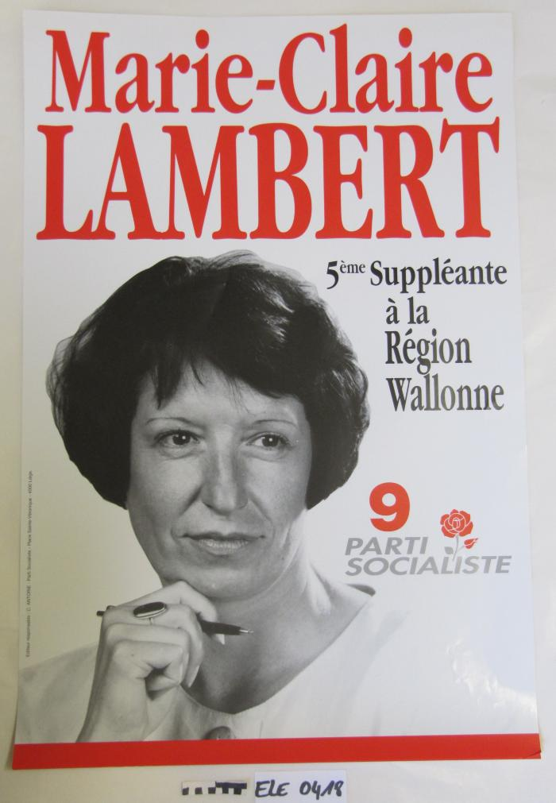
Marie-Claire Lambert (ARC-C AFF ELE 0418)

